Slide 1
Software Quality Assurance
Bryan Knowles
Nicholas Peppers
Thomas Lecoffre
Trey Jackson

Slide 2
Topics
Testing
Feedback
Maintenance
Accountability

Slide 3
QA Testing Overview
Controlled conditions and evaluating the results
Includes both normal AND abnormal conditions
Create a problem → Find a solution
“If the user is in interface A of the application while using hardware B, and does C, then D should happen.”

Slide 4
Main Goal of Testing
Meet requirements set during design and development
Function as expected
Solve problems before wide distribution
Create a satisfying product to meet needs of the stakeholders

Slide 5
Automated vs. Manual Testing
Automated Testing
Done by a machine
Prewritten scripts and repetitive tasks
Manually, would take a long time
Manual Testing
Done by human individuals
Step-by-step processes
Pass/Fail results and conclusions

Slide 6
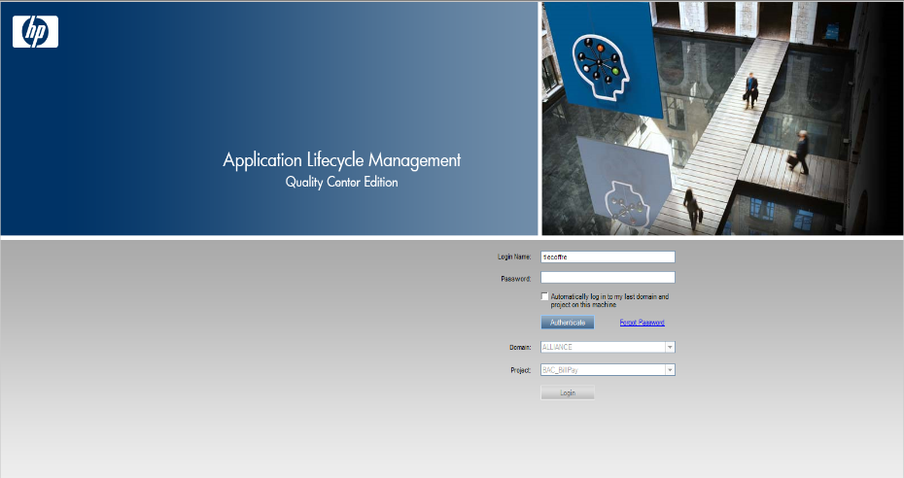
Application

Slide 7
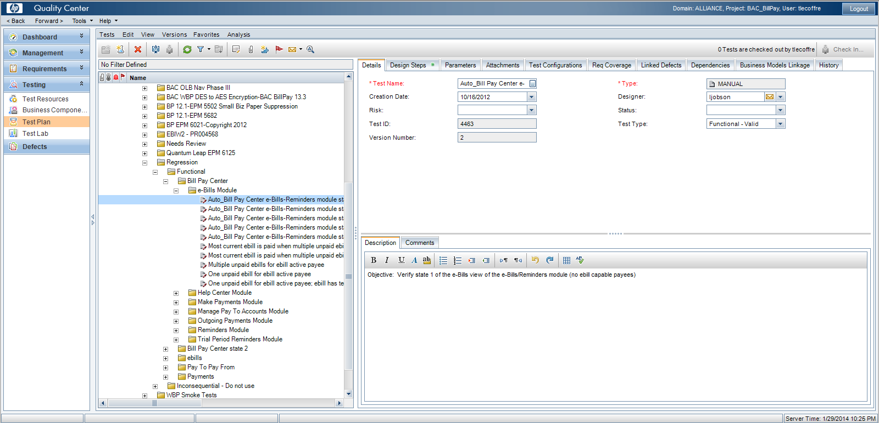
Testing Plan

Slide 8
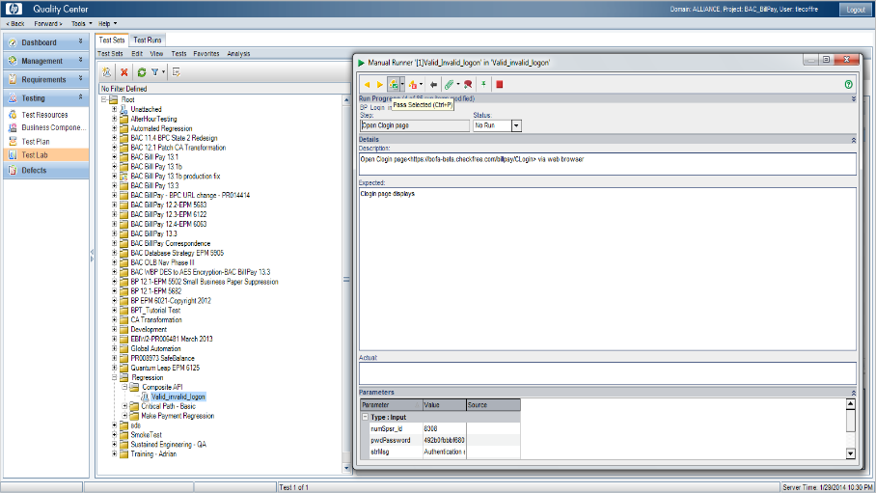
Step-by-Step Testing (Pass/Fail)

Slide 9
Feedback
Feedback is information about the product that is given to the developers.
Can be positive and negative.
Two types:
In House vs Outside

Slide 10
In House Feedback
Feedback received from the testers that work in the company.
The automated and manual testing information will be compiled and given to the developers to look at.
Will fix as many issues/bugs as they can before release.

Slide 11
Outside Feedback
Feedback received from outside sources after the product is released.
Issues or bugs that the testing phase didn’t find can be found and fixed.
It helps assure the users that the developers are listening to their concerns and trying to address their issues.
Lets the developers know whether the software is accomplishing its intended purpose the way it should be.

Slide 12
Maintenance
Is often called Support.
Maintenance and feedback are usually tied together.
Feedback received from users is a big part of it’s focus.

Slide 13
Maintenance
Once a product has been released new issues will arise.
Nothing is perfect and every possible bug can’t be accounted for.
These new issues will be organized into a most important list so that the product breaking bugs can be fixed first.
Support for a product can go on for years and the feedback received from users will help make sure that the product stays in good condition.
Windows XP released 12 years ago and is just now getting it’s support dropped.

Slide 14
Accountability
Employees are accountable through a Quality policy.
Employee performance is regularly checked.
Daily Scum
The company is occasionally audited.
Internal Auditing and External Auditing

Slide 15
Auditing
Auditing can occur from within the company or from external parties.
Internal is done be a trained staff that works at the company.
External is completed by a third party that is detailed on the company’s Quality Policy.
The root cause of a problem will be addressed. Was it the fault of the technical documents or a lazy progra

Slide 16
References
http://asq.org/learn-about-quality/software-quality/overview/overview.html
http://en.m.wikipedia.org/wiki/ISO_9000
Hitcents
Fiserv
Western IT

